Slide 1
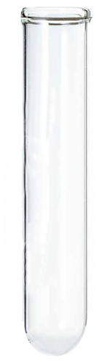



A new state space: $\{n_{A},n_{B}\}$
$$n_{B}$$
$$n_{A}$$

Slide 2


A new state space: $\{n_{A},n_{B}\}$
$$n_{B}$$
We’ll assume stock solution of A is 1 M.
$$n_{A}$$

Slide 3
A new state space: $\{n_{A},n_{B}\}$
$$n_{B}$$
$$n_{A}$$

Slide 4
A new state space: $\{n_{A},n_{B}\}$
$$n_{B}$$
We’ll assume stock solution of B is 1 M too.
$$n_{A}$$

Slide 5
A new state space: $\{n_{A},n_{B}\}$
$$n_{B}$$
$$n_{A}$$

Slide 6
Gibbs energy in this new state space
$$n_{B}$$
$$n_{A}$$

Slide 7
Gibbs energy in this new state space
But actually they’re mixed.
$$n_{B}$$
$$n_{A}$$

Slide 8
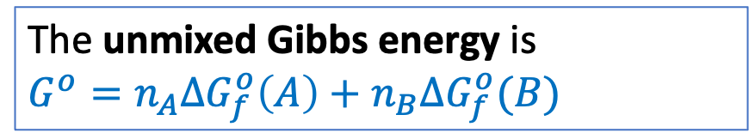
Gibbs energy in this new state space
The unmixed Gibbs energy is
${{G^{o}=n}_{A}∆G}_{f}^{o}\left(A\right)+{n_{B}∆G}_{f}^{o}(B)$
$$n_{B}$$
$$n_{A}$$

Slide 9
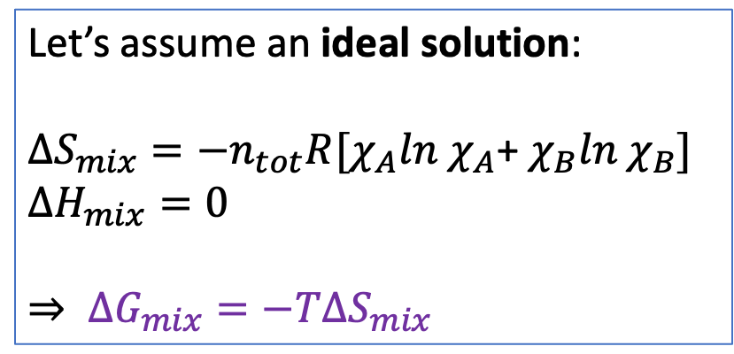
Gibbs energy in this new state space
Let’s assume an ideal solution:
$$∆S_{mix}=−n_{tot}R[χ_{A}ln χ_{A}\text{+} χ_{B}ln χ_{B}]$$
$∆H_{mix}=0$
$⇒ ∆G_{mix}=−T∆S_{mix}$
$$n_{B}$$
$$n_{A}$$

Slide 10
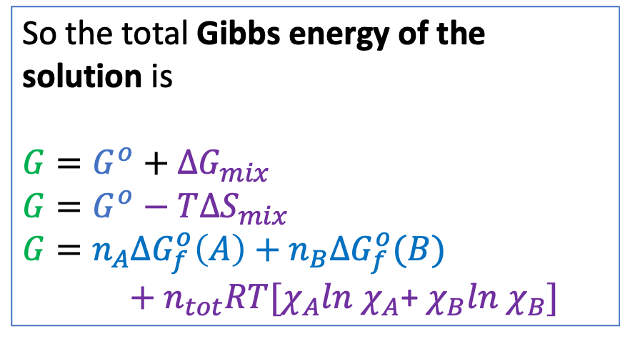
Gibbs energy in this new state space
So the total Gibbs energy of the solution is
$G=G^{o}+$ ${∆G}_{mix}$
$G=G^{o}−T∆S_{mix}$
$$G={n_{A}∆G}_{f}^{o}\left(A\right)+{n_{B}∆G}_{f}^{o}(B)$$
$+ n_{tot}RT[χ_{A}ln$ $χ_{A}$+ $χ_{B}ln$ $χ_{B}]$
$$n_{B}$$
$$n_{A}$$

Slide 11
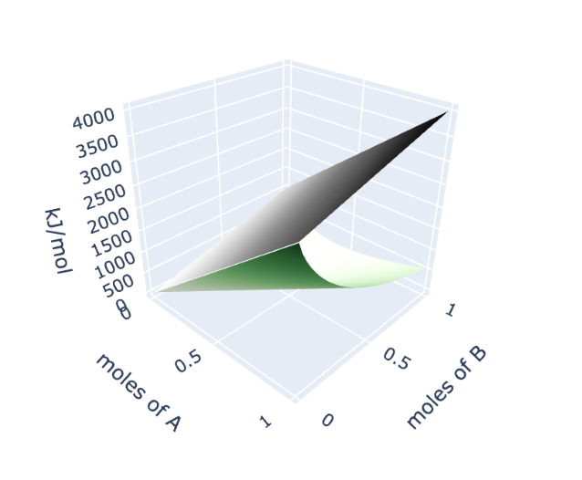
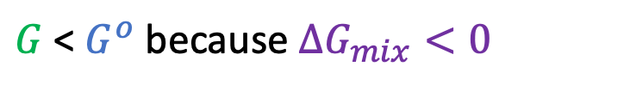



Gibbs energy in this new state space
So the total Gibbs energy of the solution is
$G=G^{o}+$ ${∆G}_{mix}$
$G=G^{o}−T∆S_{mix}$
$$G={n_{A}∆G}_{f}^{o}\left(A\right)+{n_{B}∆G}_{f}^{o}(B)$$
$+ n_{tot}RT[χ_{A}ln$ $χ_{A}$+ $χ_{B}ln$ $χ_{B}]$
$$G^{o}$$
$$∆G_{mix}$$
$$G$$
$G$ < $G^{o}$ because $∆G_{mix}<0$

Slide 12



Defining the reaction parameter $ε$
Now let’s imagine a “reaction path” $A→B$
$$G^{o}$$
$$G$$
$$ε$$
X

Slide 13
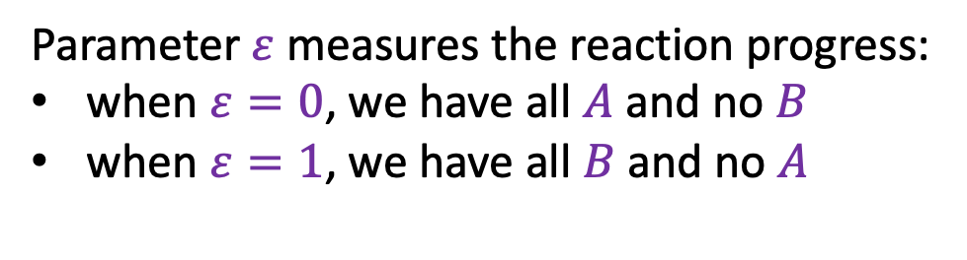
Defining the reaction parameter $ε$
Now let’s imagine a “reaction path” $A→B$
Parameter $ε$ measures the reaction progress:
when $ε=0$, we have all $A$ and no $B$
when $ε=1$, we have all $B$ and no $A$
$$G^{o}$$
$$G$$
$$ε$$
X

Slide 14
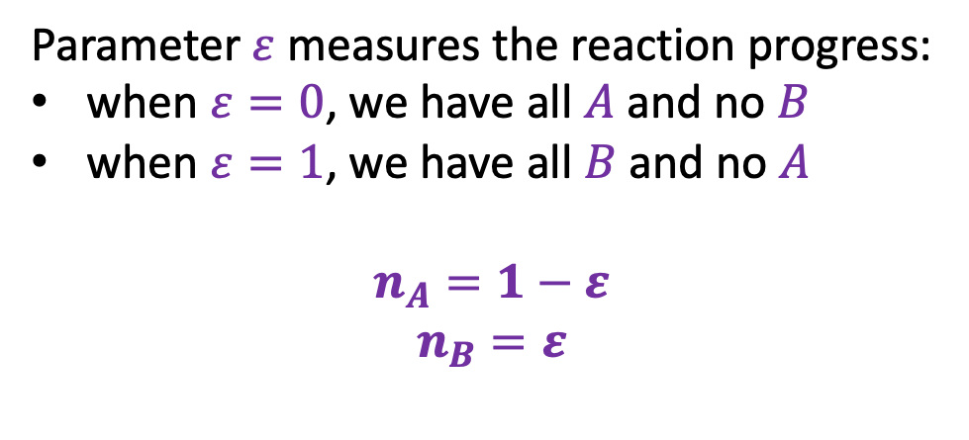
Defining the reaction parameter $ε$
Now let’s imagine a “reaction path” $A→B$
Parameter $ε$ measures the reaction progress:
when $ε=0$, we have all $A$ and no $B$
when $ε=1$, we have all $B$ and no $A$
$$n_{A}=1−ε$$
$$n_{B}=ε$$
$$G^{o}$$
$$G$$
$$ε$$
X

Slide 15
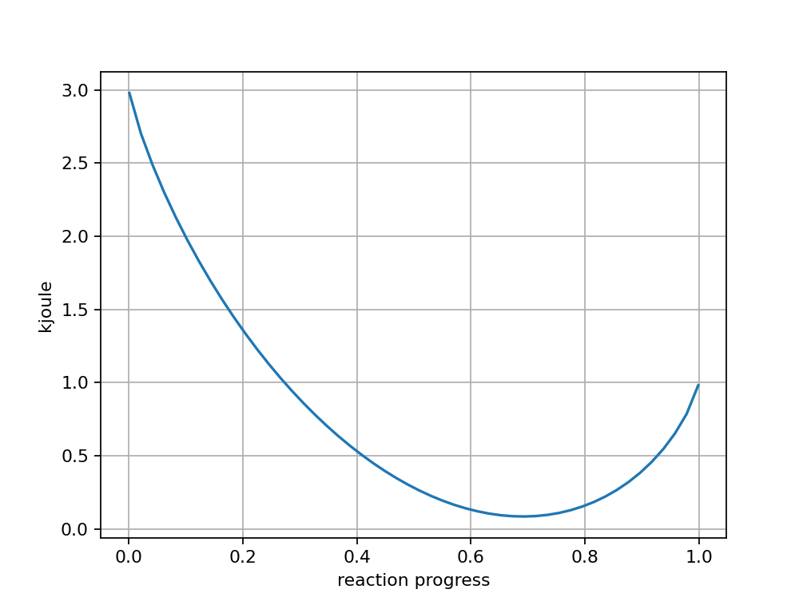

Defining the reaction parameter $ε$
Now let’s imagine a “reaction path” $A→B$
Parameter $ε$ measures the reaction progress:
when $ε=0$, we have all $A$ and no $B$
when $ε=1$, we have all $B$ and no $A$
$$n_{A}=1−ε$$
$$n_{B}=ε$$
$$G^{o}$$
$$G$$
X
$$ε$$

Slide 16
The slope of G along the reaction path
Now let’s imagine a “reaction path” $A→B$
The slope of the Gibbs energy along the reaction path can tell us how far a reaction will proceed:
Parameter $ε$ measures the reaction progress:
when $ε=0$, we have all $A$ and no $B$
when $ε=1$, we have all $B$ and no $A$
$$n_{A}=1−ε$$
$$n_{B}=ε$$
$$ε$$

Slide 17
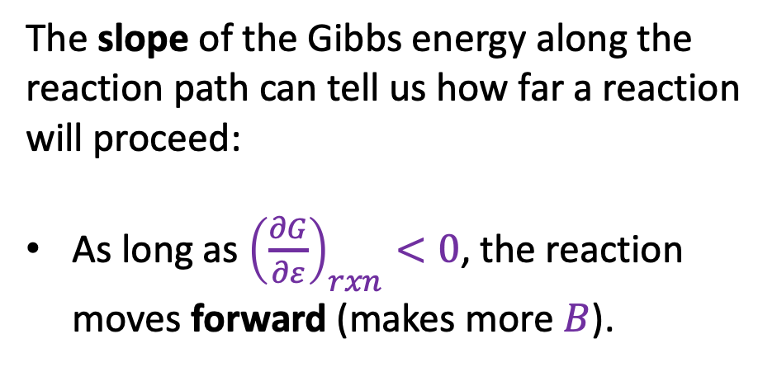
The slope of G along the reaction path
Now let’s imagine a “reaction path” $A→B$
The slope of the Gibbs energy along the reaction path can tell us how far a reaction will proceed:
As long as ${\left(\frac{∂G}{∂ε}\right)}_{rxn}<0$, the reaction moves forward (makes more $B$).
Parameter $ε$ measures the reaction progress:
when $ε=0$, we have all $A$ and no $B$
when $ε=1$, we have all $B$ and no $A$
$$n_{A}=1−ε$$
$$n_{B}=ε$$
$$ε$$

Slide 18
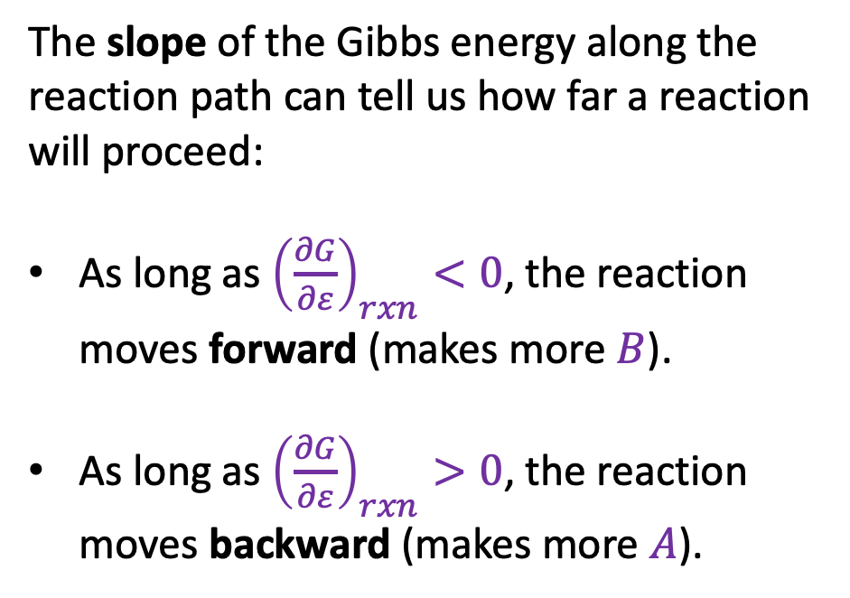
The slope of G along the reaction path
Now let’s imagine a “reaction path” $A→B$
The slope of the Gibbs energy along the reaction path can tell us how far a reaction will proceed:
As long as ${\left(\frac{∂G}{∂ε}\right)}_{rxn}<0$, the reaction moves forward (makes more $B$).
As long as ${\left(\frac{∂G}{∂ε}\right)}_{rxn}>0$, the reaction moves backward (makes more $A$).
Parameter $ε$ measures the reaction progress:
when $ε=0$, we have all $A$ and no $B$
when $ε=1$, we have all $B$ and no $A$
$$n_{A}=1−ε$$
$$n_{B}=ε$$
$$ε$$

Slide 19
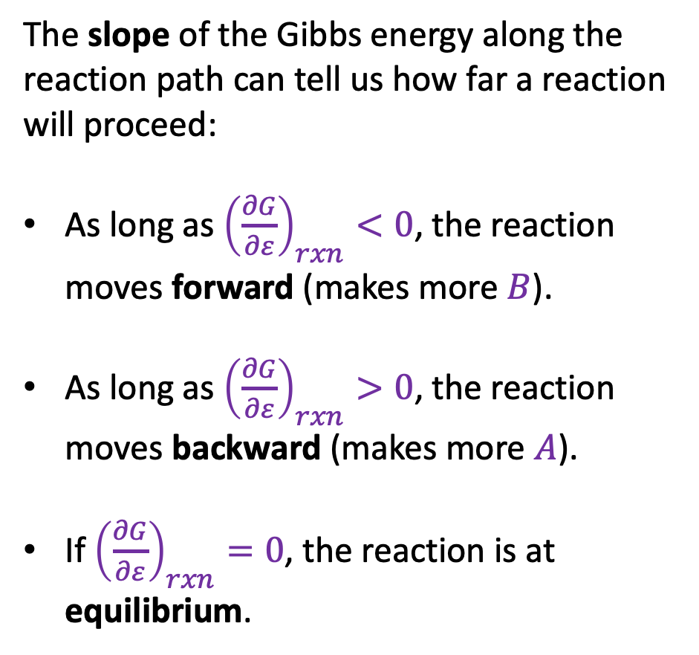
The slope of G along the reaction path
Now let’s imagine a “reaction path” $A→B$
The slope of the Gibbs energy along the reaction path can tell us how far a reaction will proceed:
As long as ${\left(\frac{∂G}{∂ε}\right)}_{rxn}<0$, the reaction moves forward (makes more $B$).
As long as ${\left(\frac{∂G}{∂ε}\right)}_{rxn}>0$, the reaction moves backward (makes more $A$).
If ${\left(\frac{∂G}{∂ε}\right)}_{rxn}=0$, the reaction is at equilibrium.
Parameter $ε$ measures the reaction progress:
when $ε=0$, we have all $A$ and no $B$
when $ε=1$, we have all $B$ and no $A$
$$n_{A}=1−ε$$
$$n_{B}=ε$$
$$ε$$

Slide 20
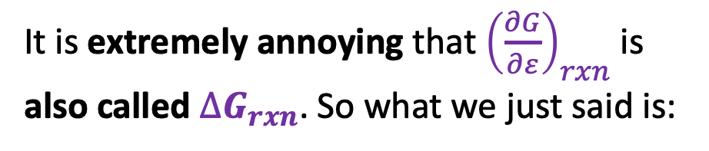
The slope of G along the reaction path
Now let’s imagine a “reaction path” $A→B$
It is extremely annoying that ${\left(\frac{∂G}{∂ε}\right)}_{rxn}$is also called $∆G_{rxn}$. So what we just said is:
Parameter $ε$ measures the reaction progress:
when $ε=0$, we have all $A$ and no $B$
when $ε=1$, we have all $B$ and no $A$
$$n_{A}=1−ε$$
$$n_{B}=ε$$
$$ε$$

Slide 21

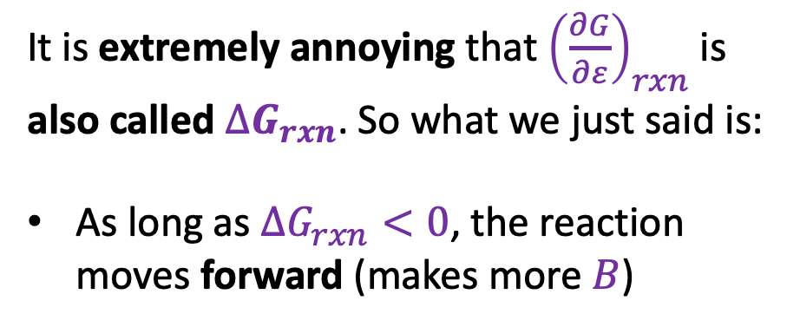
The slope of G along the reaction path
Now let’s imagine a “reaction path” $A→B$
It is extremely annoying that ${\left(\frac{∂G}{∂ε}\right)}_{rxn}$is also called $∆G_{rxn}$. So what we just said is:
As long as $∆G_{rxn}<0$, the reaction moves forward (makes more $B$)
Parameter $ε$ measures the reaction progress:
when $ε=0$, we have all $A$ and no $B$
when $ε=1$, we have all $B$ and no $A$
$$n_{A}=1−ε$$
$$n_{B}=ε$$
$$∆G_{rxn}<0$$
$$ε$$

Slide 22

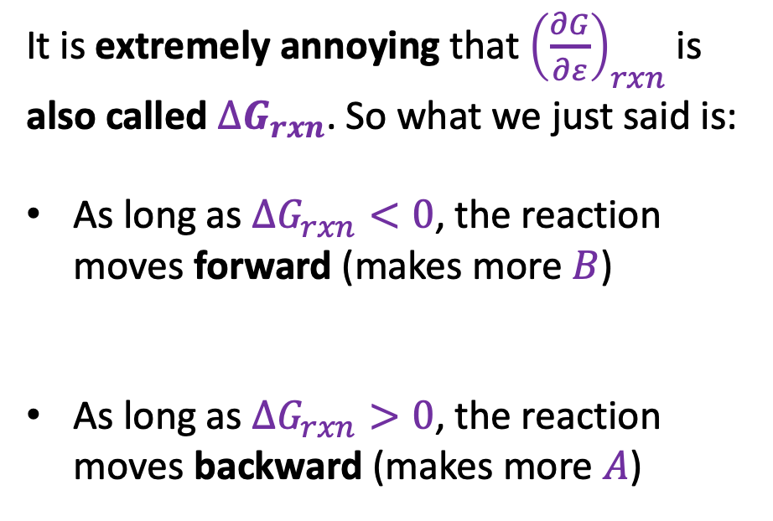
The slope of G along the reaction path
Now let’s imagine a “reaction path” $A→B$
It is extremely annoying that ${\left(\frac{∂G}{∂ε}\right)}_{rxn}$is also called $∆G_{rxn}$. So what we just said is:
As long as $∆G_{rxn}<0$, the reaction moves forward (makes more $B$)
As long as $∆G_{rxn}>0$, the reaction moves backward (makes more $A$)
Parameter $ε$ measures the reaction progress:
when $ε=0$, we have all $A$ and no $B$
when $ε=1$, we have all $B$ and no $A$
$$n_{A}=1−ε$$
$$n_{B}=ε$$
$$∆G_{rxn}<0$$
$$∆G_{rxn}>0$$
$$ε$$

Slide 23
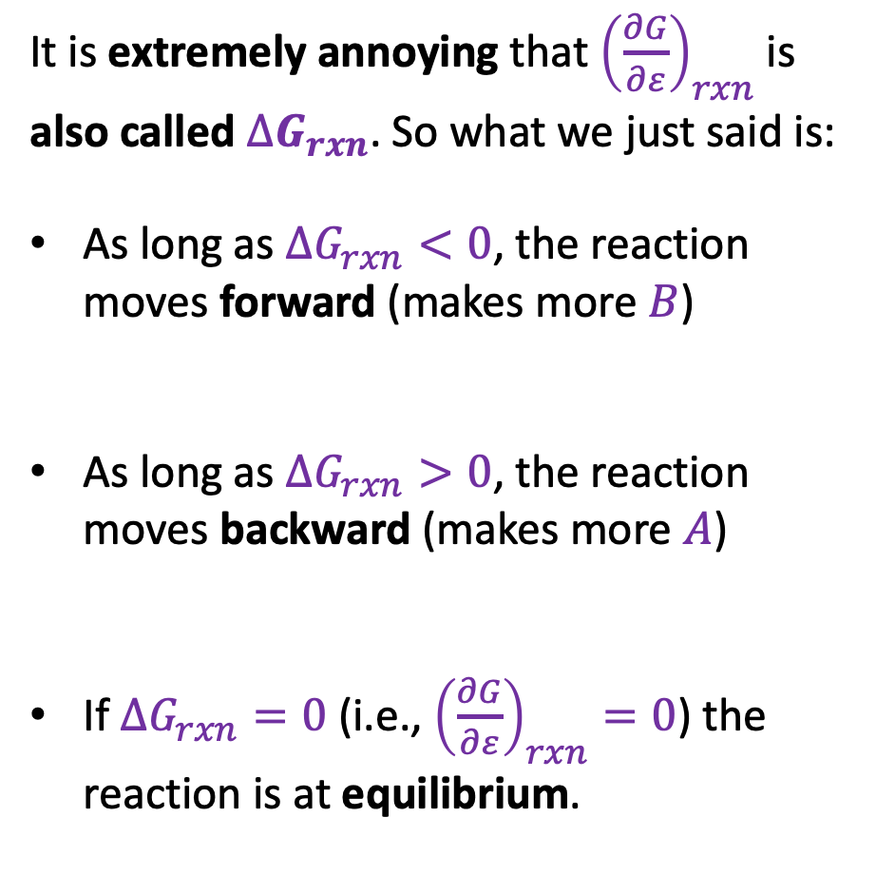

The slope of G along the reaction path
Now let’s imagine a “reaction path” $A→B$
It is extremely annoying that ${\left(\frac{∂G}{∂ε}\right)}_{rxn}$is also called $∆G_{rxn}$. So what we just said is:
As long as $∆G_{rxn}<0$, the reaction moves forward (makes more $B$)
As long as $∆G_{rxn}>0$, the reaction moves backward (makes more $A$)
If $∆G_{rxn}=0$ (i.e., ${\left(\frac{∂G}{∂ε}\right)}_{rxn}=0$) the reaction is at equilibrium.
Parameter $ε$ measures the reaction progress:
when $ε=0$, we have all $A$ and no $B$
when $ε=1$, we have all $B$ and no $A$
$$n_{A}=1−ε$$
$$n_{B}=ε$$
$$∆G_{rxn}<0$$
$$∆G_{rxn}>0$$
$$∆G_{rxn}=0$$
$$ε$$

Slide 24
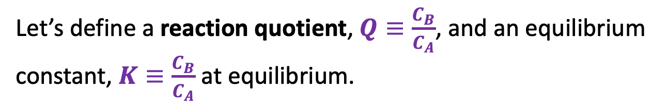




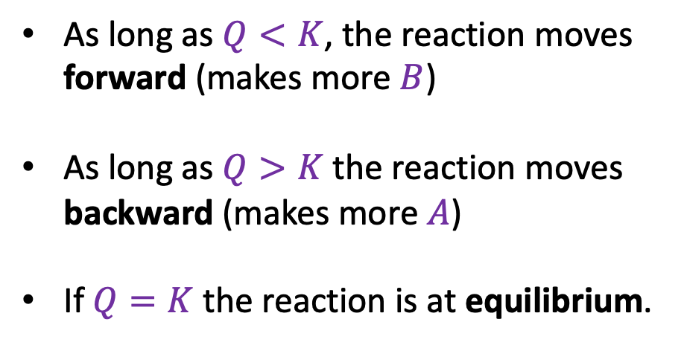
The reaction quotient and the equilibrium constant
Still imagining a “reaction path” $A→B$
Let’s define a reaction quotient, $Q≡\frac{C_{B}}{C_{A}}$, and an equilibrium constant, $K≡\frac{C_{B}}{C_{A}}$ at equilibrium.
As long as $Q<K$, the reaction moves forward (makes more $B$)
As long as $Q>K$the reaction moves backward (makes more $A$)
If $Q=K$ the reaction is at equilibrium.
$$Q<K$$
$$Q=K$$
$$Q>K$$
$$ε$$

Slide 25
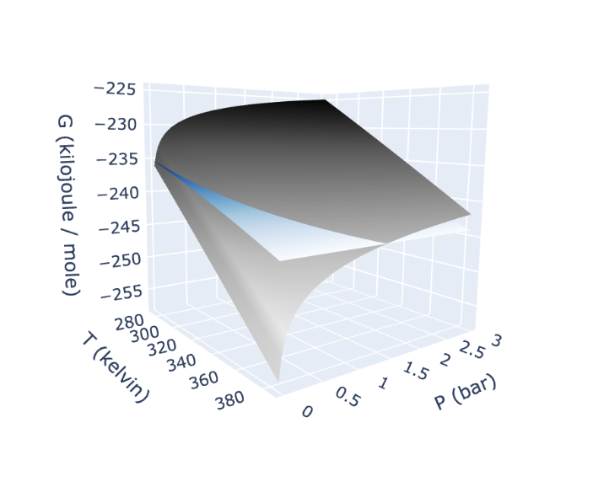
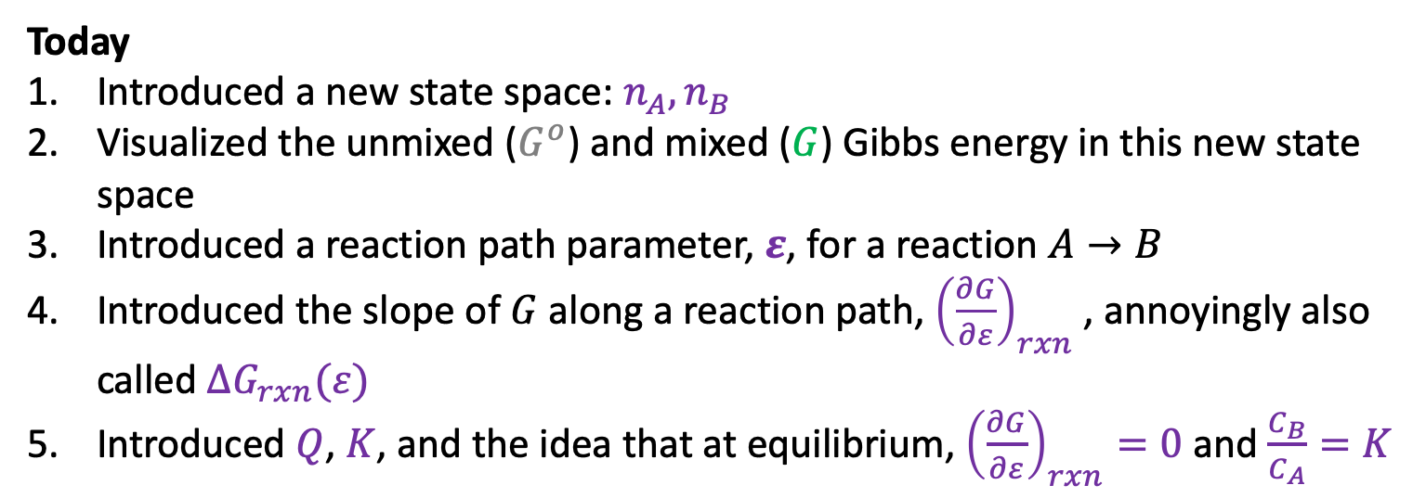
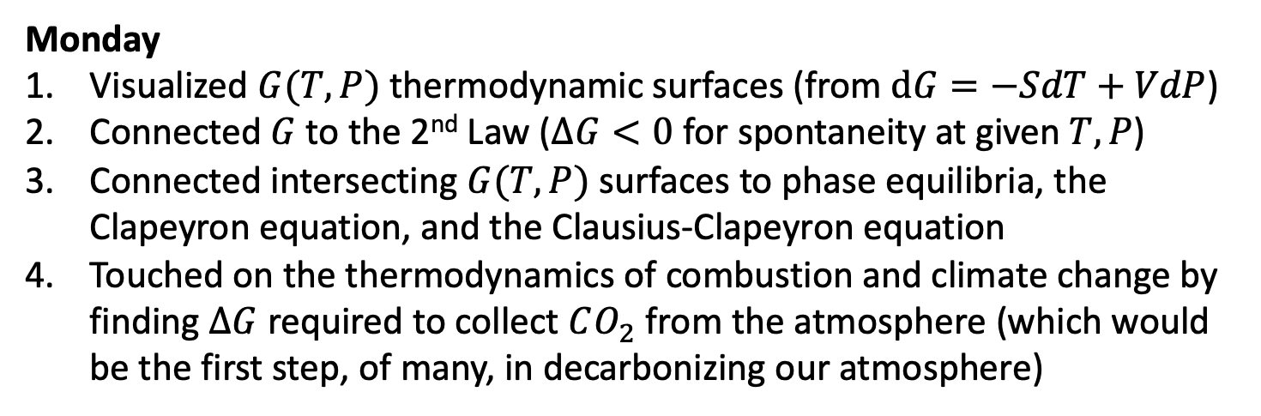



Summary
Monday
Visualized $G(T,P)$ thermodynamic surfaces (from $dG=−SdT+VdP$)
Connected $G$to the 2nd Law ($∆G<0$ for spontaneity at given $T,P$)
Connected intersecting $G(T,P)$ surfaces to phase equilibria, the Clapeyron equation, and the Clausius-Clapeyron equation
Touched on the thermodynamics of combustion and climate change by finding $∆G$ required to collect $CO_{2}$ from the atmosphere (which would be the first step, of many, in decarbonizing our atmosphere)
Gas
Liquid
$$G^{o}$$
Today
Introduced a new state space: $n_{A},n_{B}$
Visualized the unmixed ($G^{o}$) and mixed ($G$) Gibbs energy in this new state space
Introduced a reaction path parameter, $ε$, for a reaction $A→B$
Introduced the slope of $G$ along a reaction path, ${\left(\frac{∂G}{∂ε}\right)}_{rxn}$ , annoyingly also called $∆G_{rxn}(ε)$
Introduced $Q$, $K$, and the idea that at equilibrium, ${\left(\frac{∂G}{∂ε}\right)}_{rxn}=0$ and $\frac{C_{B}}{C_{A}}=K$
$$G$$
$$ε$$

Slide 26
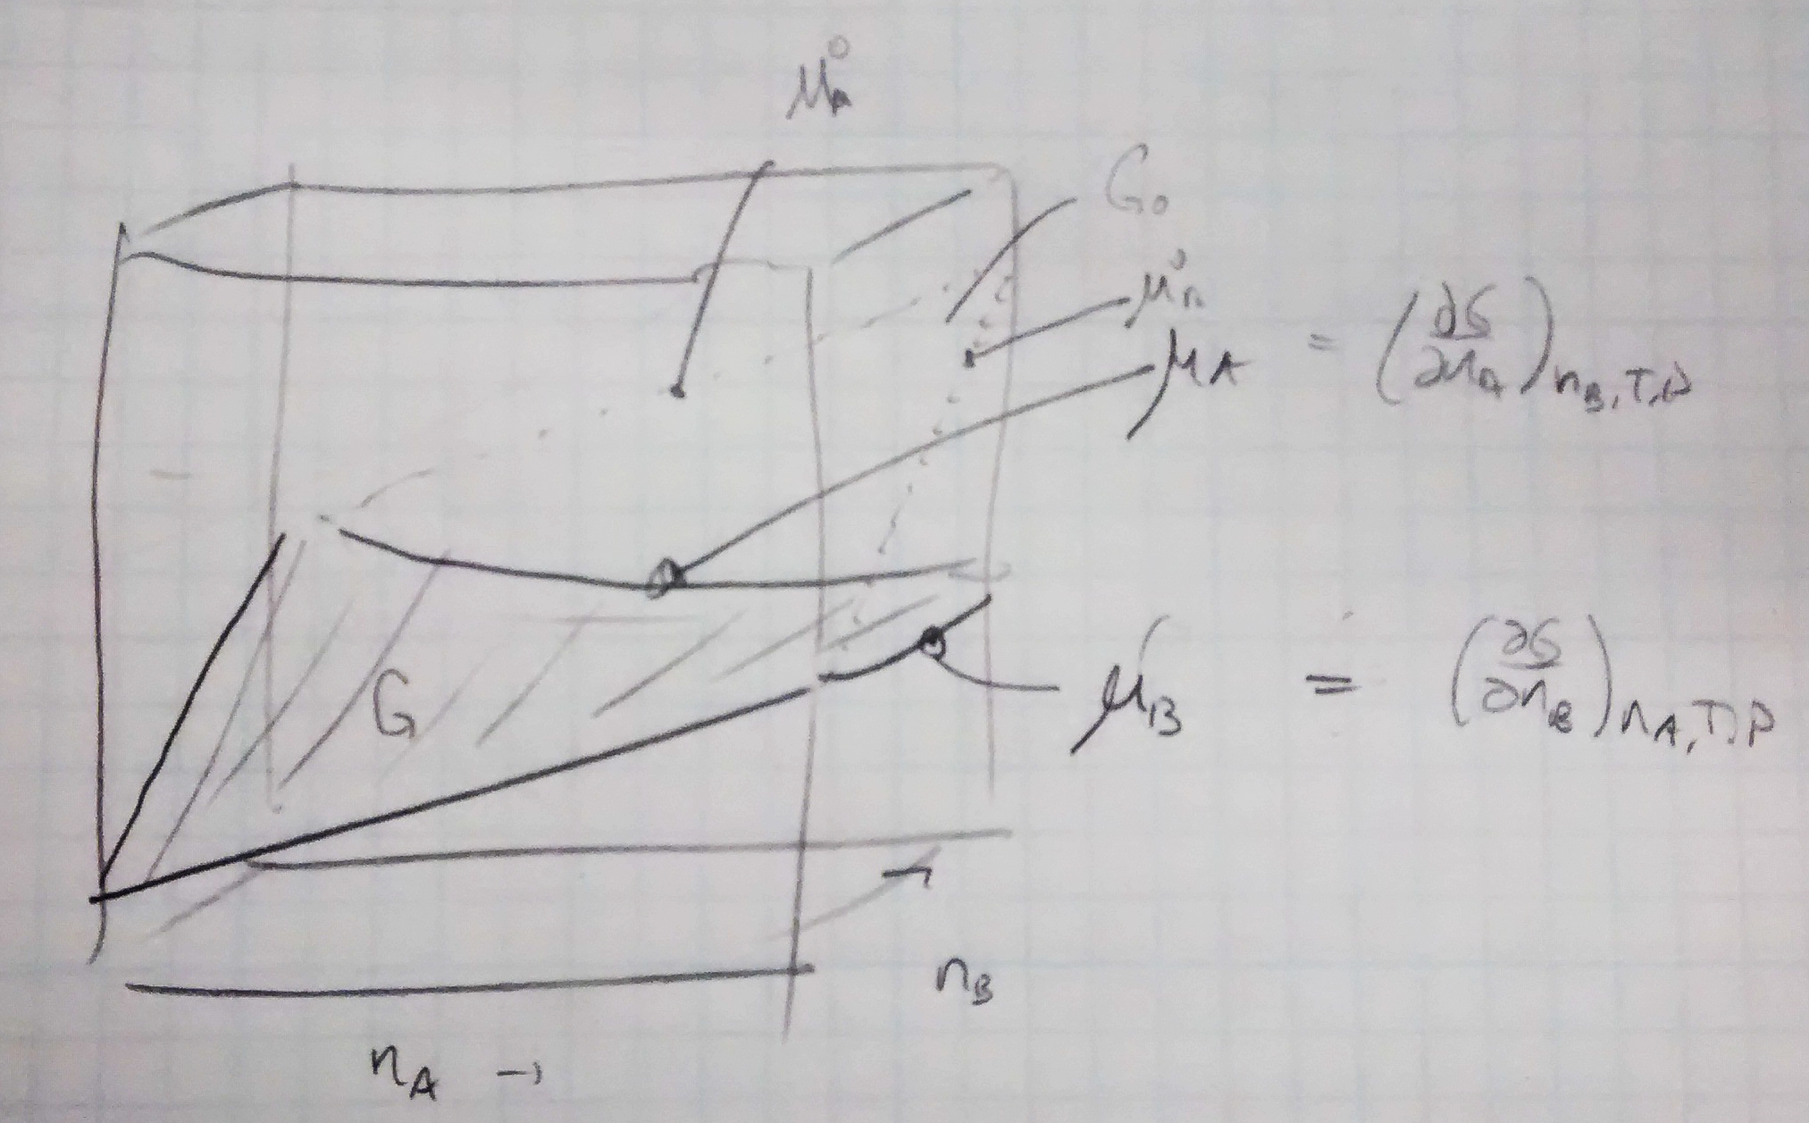


Before there was Python to help learn Thermo …
$$G^{o}$$
$$G$$

Slide 27
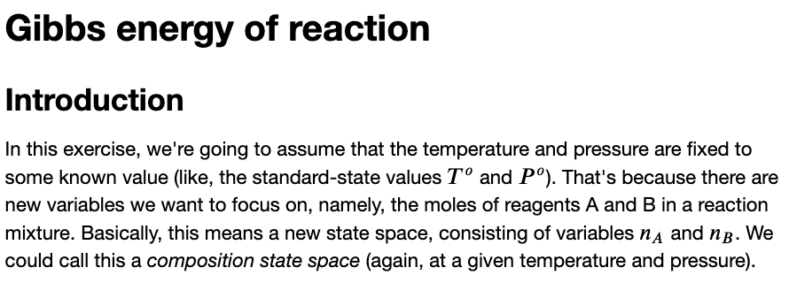
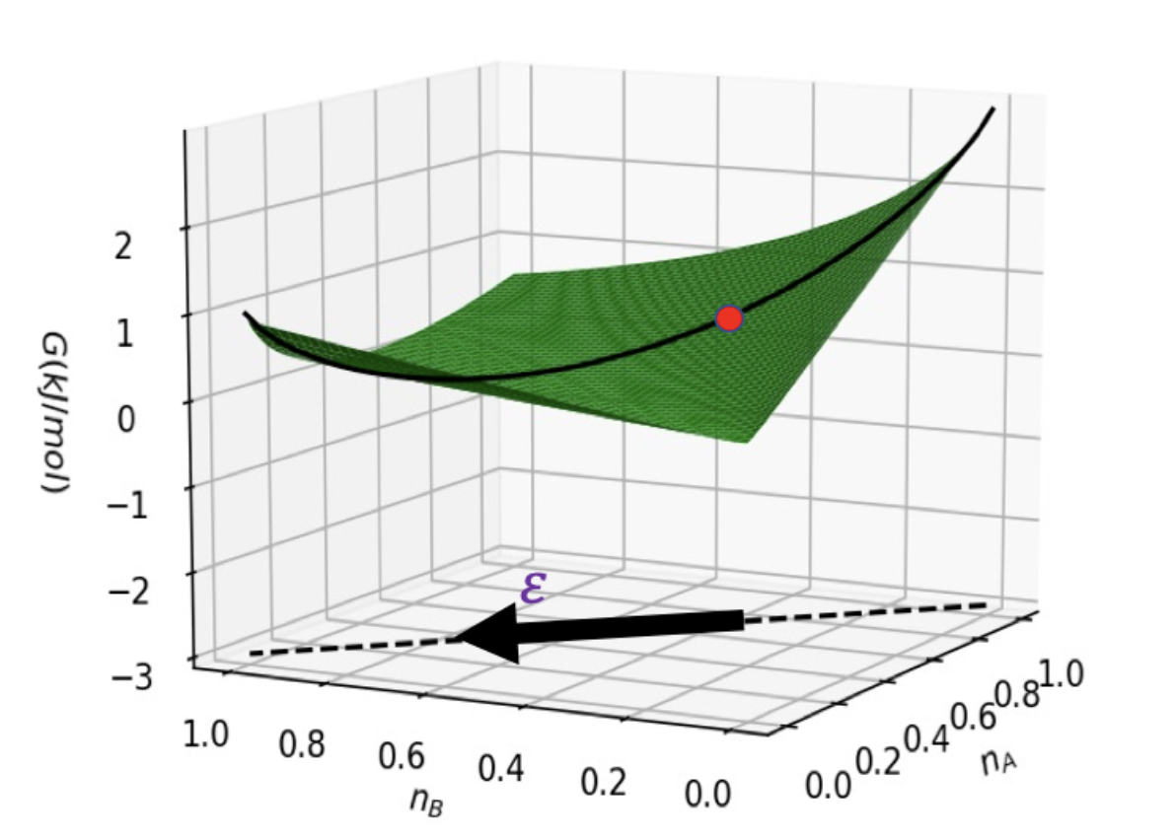
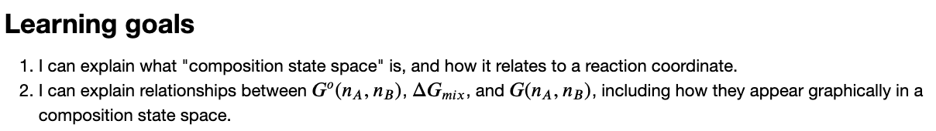
The CGI associated with this

